Slide 1
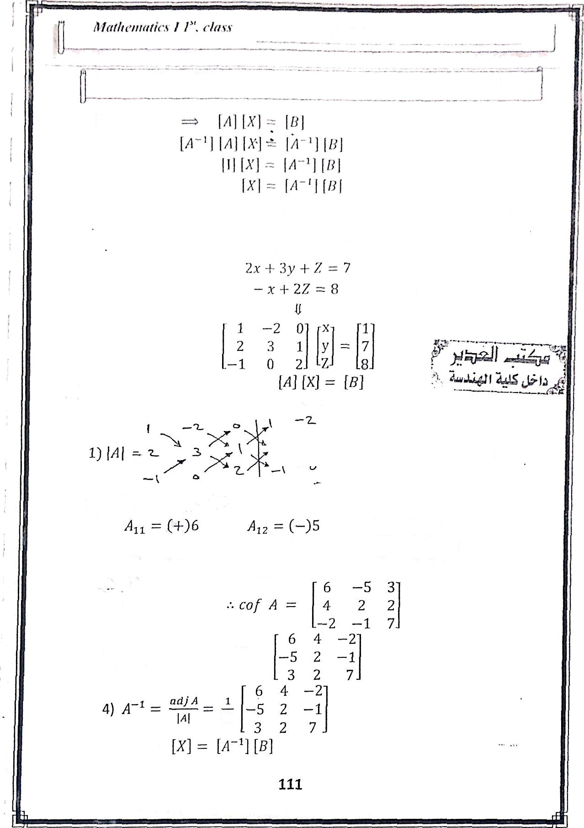

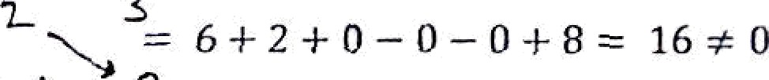
Sys. of eqs.
2j cod A
Az z (+)3
All ( ) 4 A (+)2
A= (+) 2 A3 - ( )1
ż 23 — ( )
^{A}33
(+)*
3 ) adj A
[cof A] ^ -•
16

Slide 2

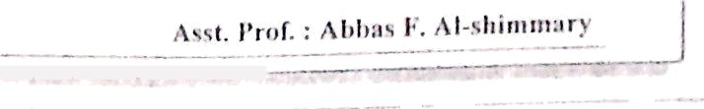








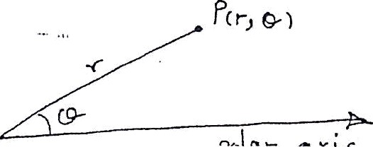
Malh‹'tii‹itie.s I /“. clues
1 -1 7
2 7 R
(6)(1) + (fi)(7) 4-(—2)(g)
(—S)(1) +(2)(7) +(—1)(8)
(3) 1) + (2)(7) + (7)(g)
18/16
- 1/1G 73/16
16
Note : there is quick method to find
J ”' for order 2
! ‹!
Let [fl)
Then [fl '] =
ad — be !—c a
H.W/(1) Solve the sys. For Linear equa ons using 1- Grammer's rule.
2- Inverse Matrix Method
—z + 2y + 3Z —— 1
2z + Z —— —2
4s — 2y I- £ = 3
 | 4 | —7 | 6
{2} Find the adjoint of | —2 | 4 | 0
 | S | 7 | —4
 | 4 | —7 | 6
(2) Find the inverse of | —2 | 4 | 0
 | 5 | 7 | —4
Polar Coordinates
In this section we shall introduce a new' kind of coordinate system called polar coordinates that will be easier to work with in many problems
the point p ( r , & ) can be represent in
Polar coo . as :

Slide 3
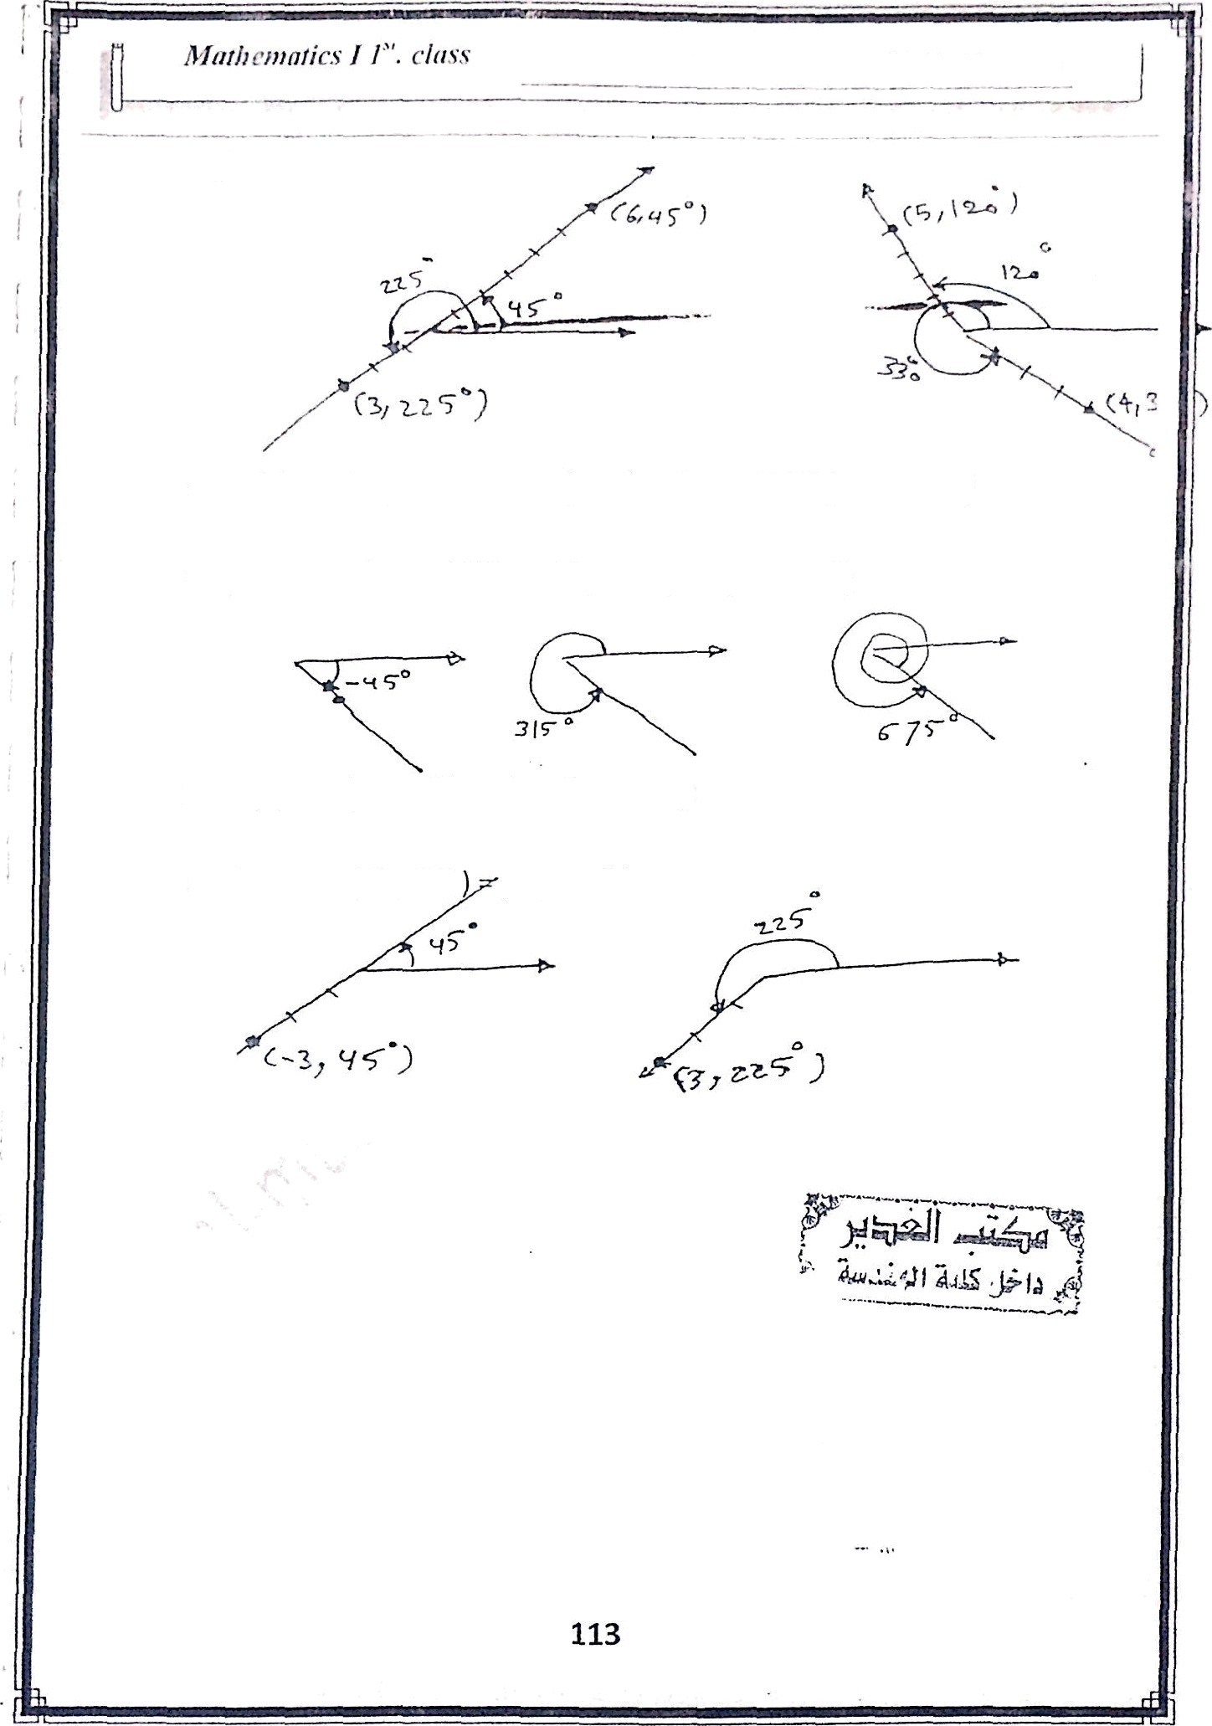
ex/
note(l
(r, 6-Fzi860’)-(r,d-n 330)=(r,0)
( 1 , —4S‘ ) = ( 1 , 315‘ ) = ( 1 , fi75")
ex /
note {2)
( —r , a ) = ( » , a + mo‘)
(3,45’ (3,125’)
ex/

Slide 4
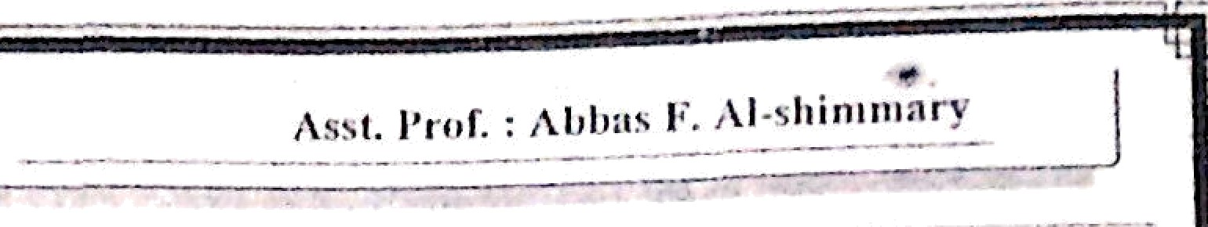
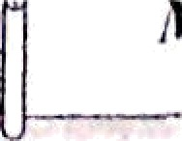
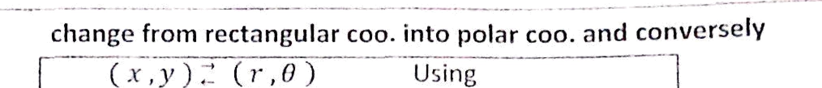
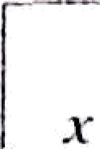
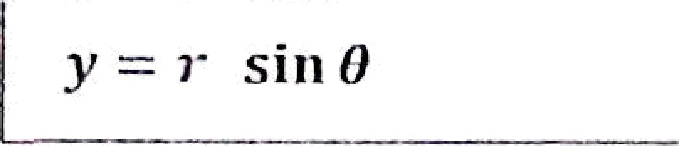
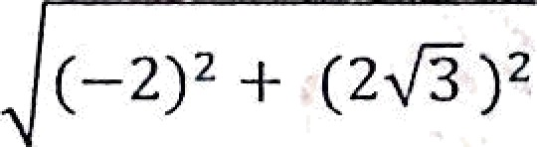
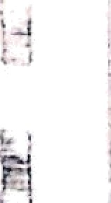


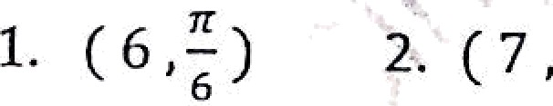







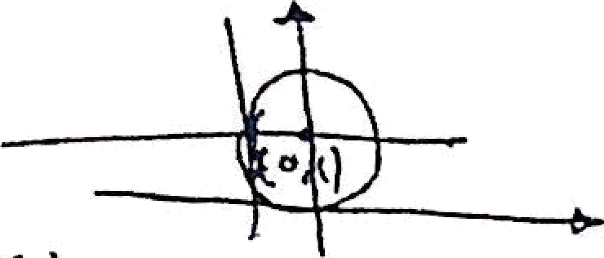


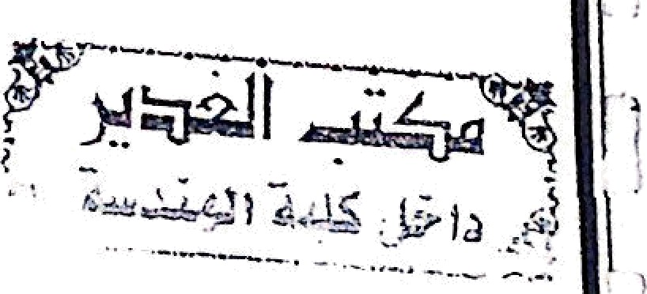
æ=› cost
y = i sin 8
=w r=
y
8 =
ta n* ¹
ex/ Find the rectangular coo . of
( 6 , ù5"
y = i sin 8 —— 6 sin(135‘) — 6 ) — 3
the poin t is ( —3 2 , 3 )
Ex / Find the polar cao. of
—2 , 2 3 )
8 = tan
siwce
1
= tan*'
2
“,
. ’ t an^{‘ 1}
3
x
-2 3
( —2 , 2 3)
lies où the second quad rent a
the oïrit is ( 4,
3
H.W/ (1) rectangular coö . of the point to
3
) 3. (8,
91
) 4. (0 , )
(2) Find the
,olar coo . of the points
1. ( 2 ,fÑ,—2)
2. ( 0 ,—2 ) 3. ( 1 , 1 )
into rectangular coo.
4. (—3 , 3 >/Ñ)
- ex: Change r -
2 sin 8
r = 2 sin 8
r' = 2 r*sin 8
multiplied by r
y2
x ² + 2 y 3- 1 — 1 = 0
° t
x’ + (y — i )' = 1
Which is circle of radius =1 and center = ( o , 1 )
114

Slide 5
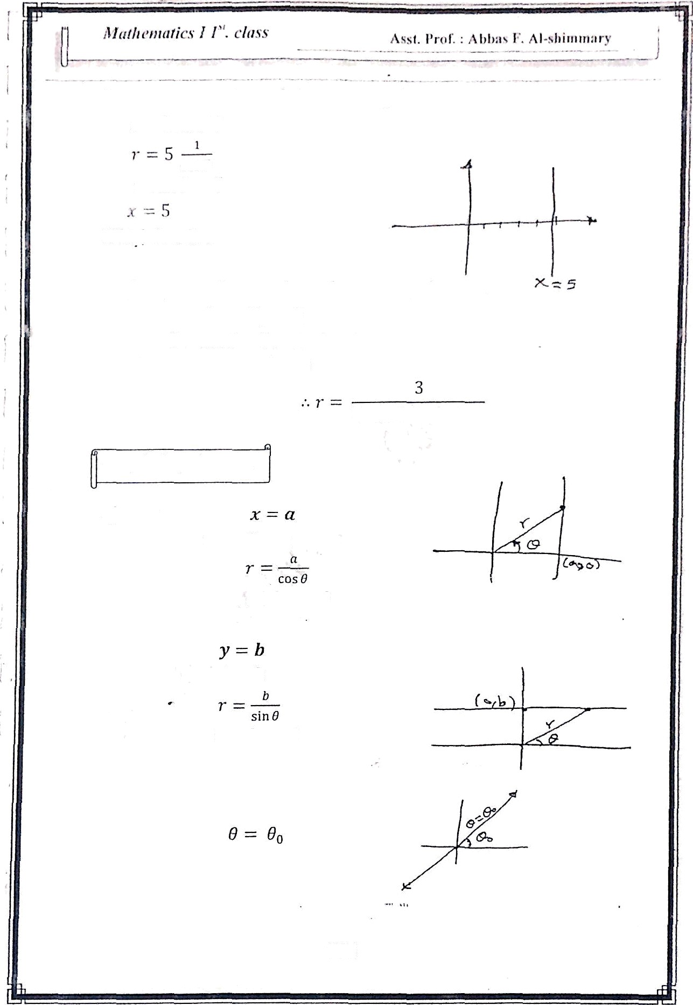
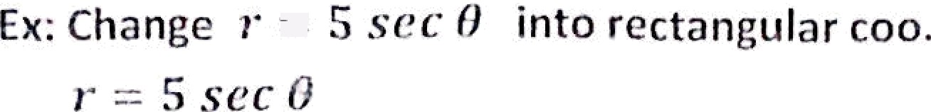


cue 0
i cos f 5
EX / eKpress the sq
Sg 3 in polar coo .
2x
2 i’ cos 6
5y 3
3 i siii d 3
r ( ? cos 8 5 sin 0 ) - 3
2 cos 8
5 sin 8
Graphs in polar coo.
1) Lines
r - n sec 8
r sin 8 - b
r b csc 8

Slide 6

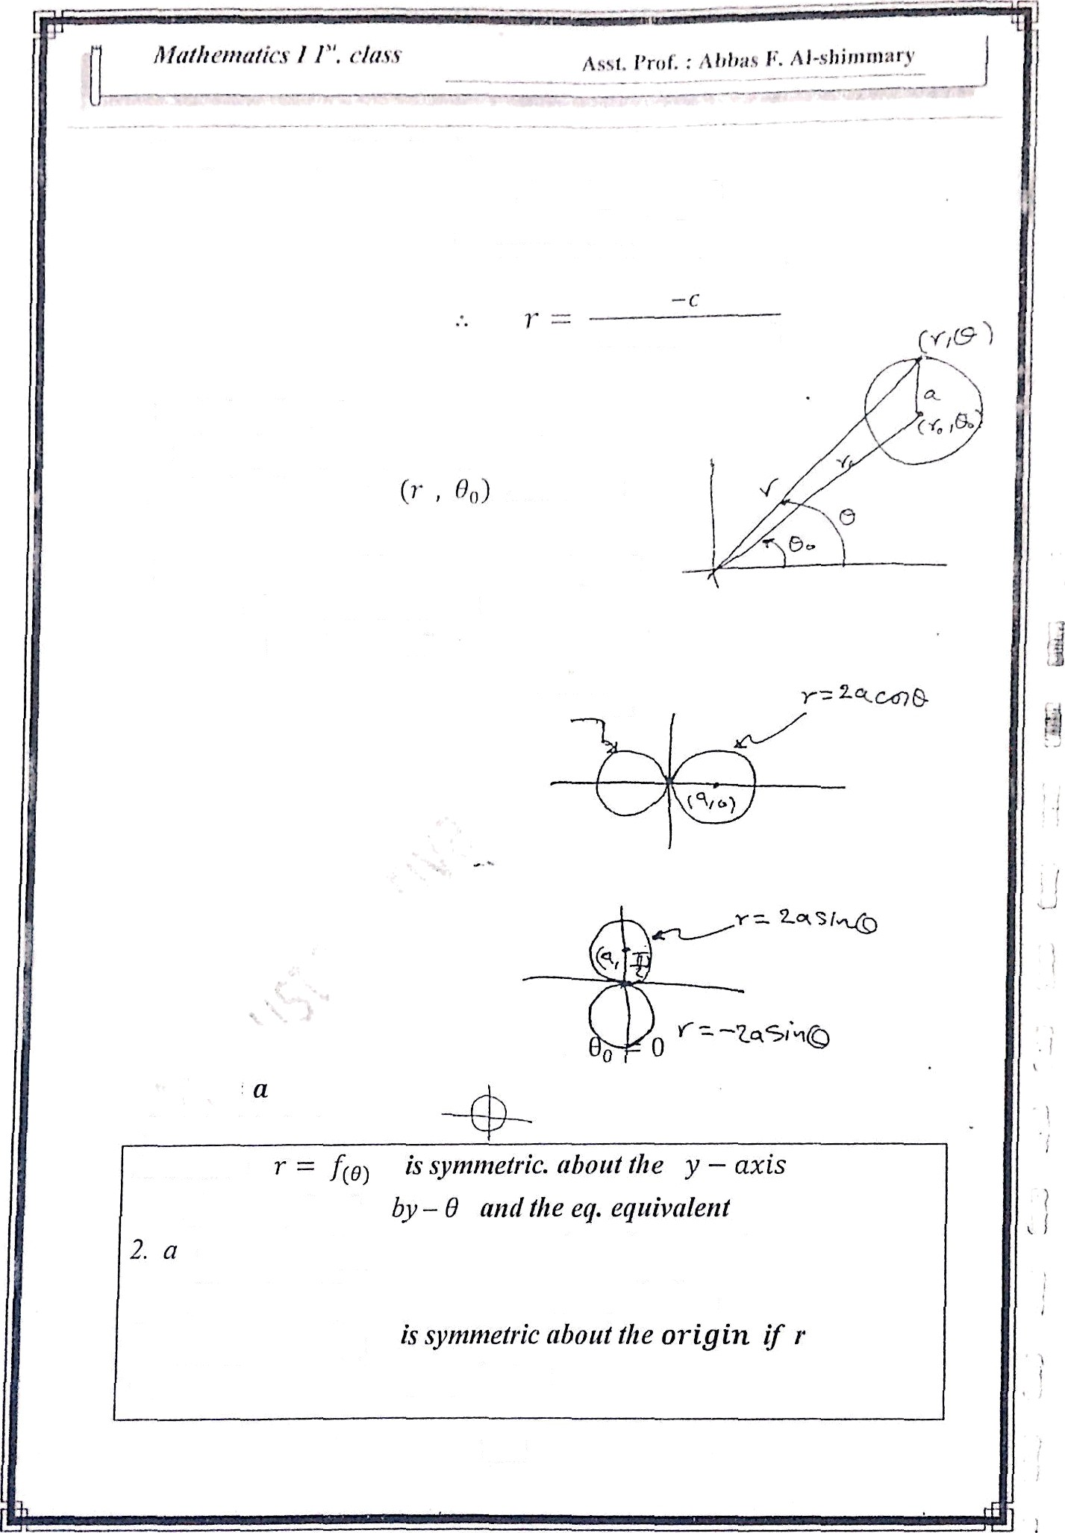


The general «q. of the line is
›• Cf›fi J -I S Y SiR 0 = —
q cos fl 4 I
sin 0
2- Circles in polar coo .
r' + r„² 2 i• ”() COS( 0 — 0 _{s} ) — n ² rc;3›-esent
e cixcfe of Center and r = a
11 the center ( a , 0 ) oi• • = a ,
*
₌ 0
r ² — 1 ar cos 8 = 0
-
lf the_{s}ceeter [ 0 , 0 ) o•
Symmetric tesf
1. a curve
If 8 replectd
-— 0
,
cume r -- (f ₈) is symmetric nbout the x - axis
¡/8 replaced by ii - 8 and the eg. equivalent.
3. a curve r —— f;$)
repliiki:d by -r and the eg.-eqiiivnletit
116

Slide 7
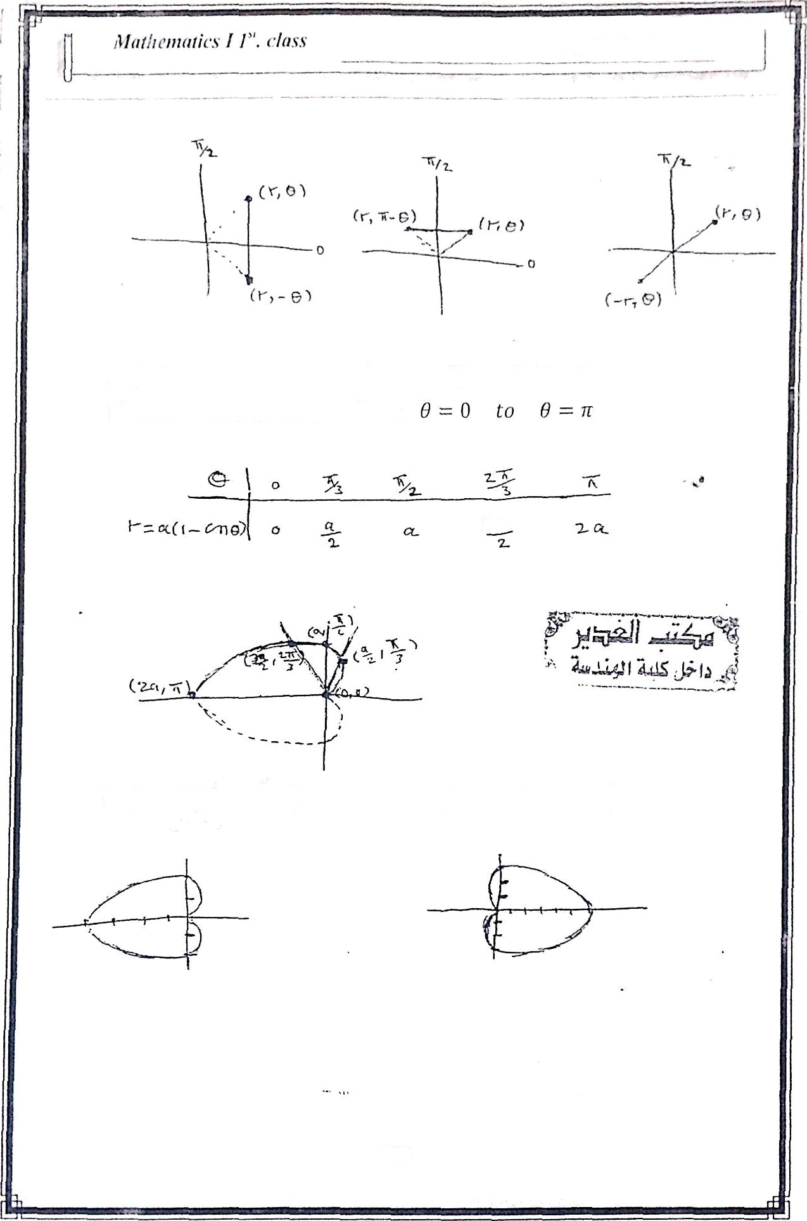
/\Sht. ] ł"‹iÊ. : 1 I ›I›:ï x I’”. , I)
-* lï İ r î!!*!'! r*'
Ex / sketch the curve › = rz/J — co.S ü)
about i — u.zts so we draw from
cardíoids . it is symm.
Ex / I — 2(1 — cos 6)
ex / r -- 3(1 + cos 8)
117

Slide 8
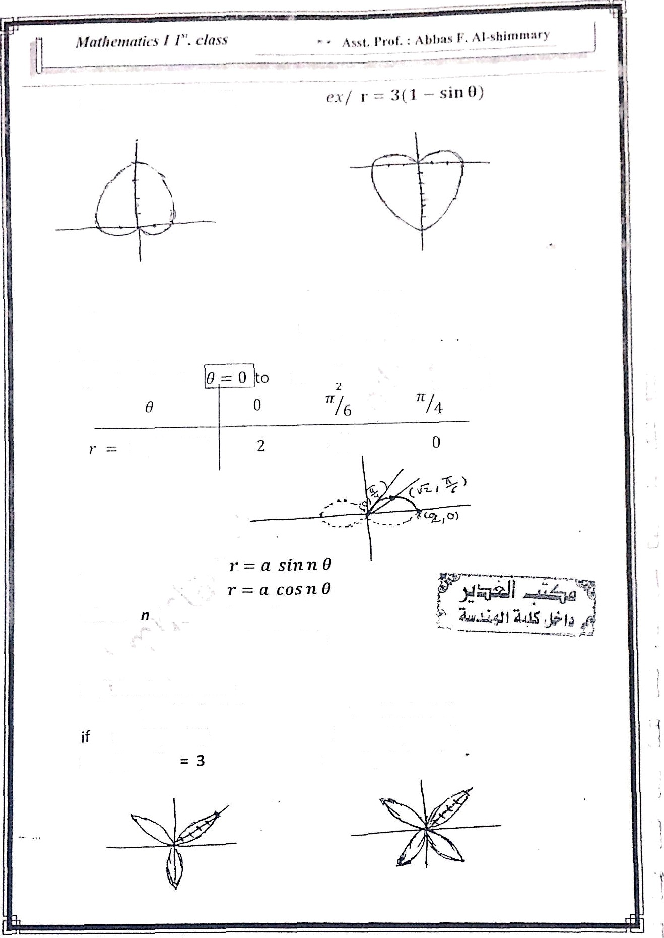


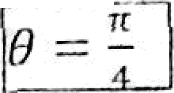


_{ex/} sketch graph of the curve r'
—— 4 CO.1 ”
r = 2co«/"""/ ?i/
the curve is symrri. about x — axis & and ^{about}
SO 28=0 -
2 c s 8
Rose curves ex/
where
is no . of petals
a is the length of petals
ex / sketch the curves
r = 5 sin 2 8
if n = 2 ( even )
no . of petals = 4
n = 3 ( odd )
no. of petals

Slide 9
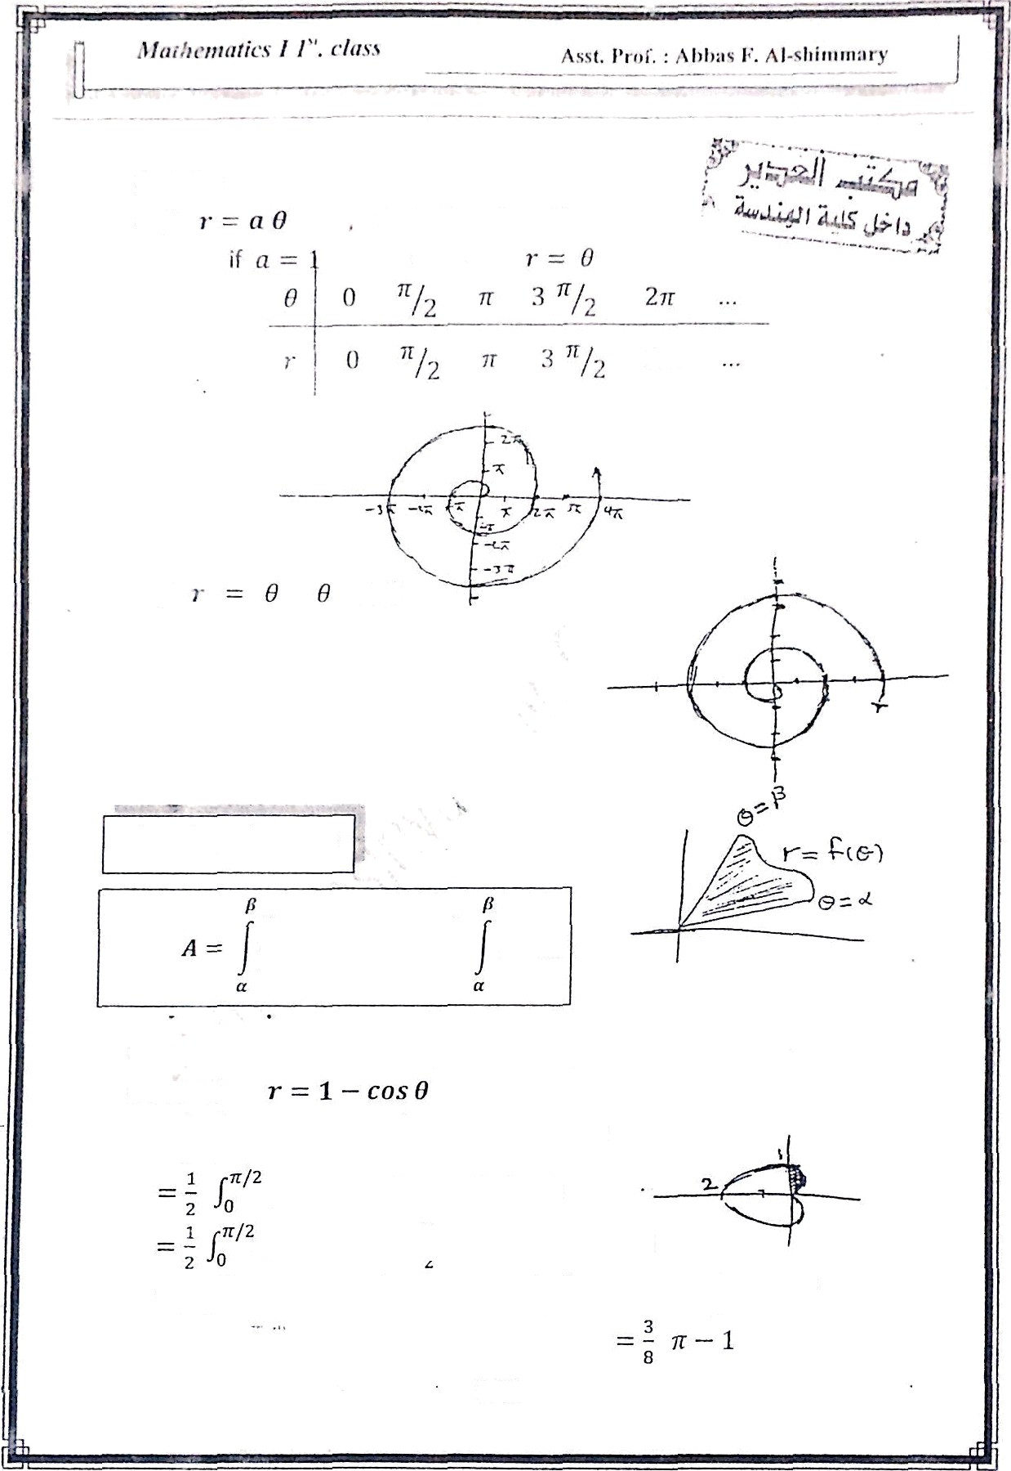








c«/
ex/
< 0
Area in polar coo :
² d 8 -
2
ex / Find the area of the region in first quadrant within the
cardioid
A -
2
d8 —
' ²(1
cos
2
d
cos 8
cos ²
d8
(1 2 cos 8 4 (1 + cos 2fi) dfl
- COS 2 8 ) d8 --
1 .
/ _{o}
'(2 — COS & 1
-sin
119

Slide 10
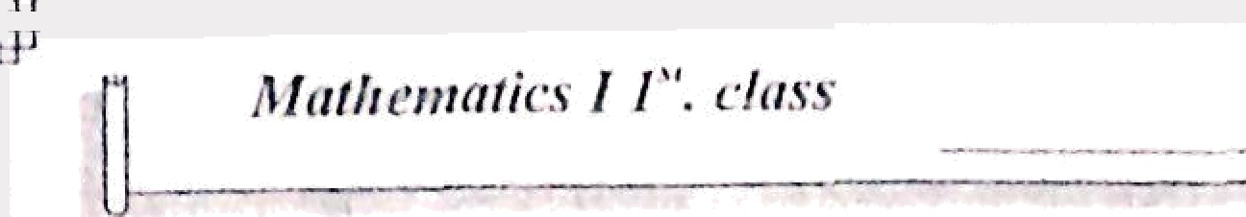

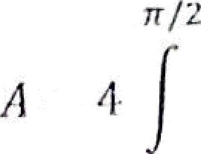
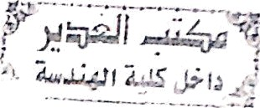
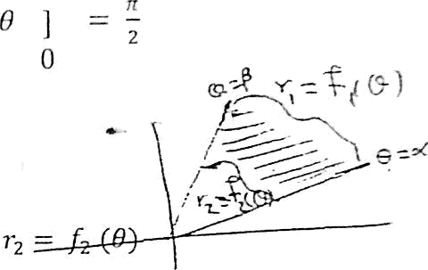
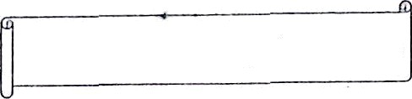



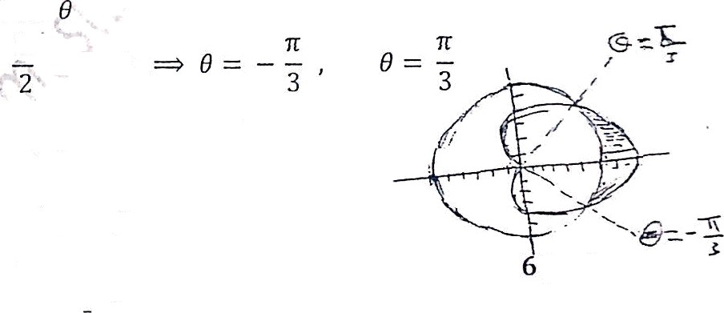
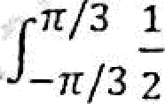

ex/ Find the area of the region enclosed by the rose ^{curve}
From symmetry of the petals
— r’ ‹18
2
? / "[sin ? 0 l' * *
2 " (1 — cos 4 0 ) d 8
[8 ——sin 4
”
Area between two polar curves :
A —— / , [ x/ r, jd8
eM Finl the aretf of the region lhnt is insiile the corilioid
r = 4 + 4 cos 8 unJ outside i- - 6
6
4 + 4 cos 8 to find the points of intersection
2 = 4 cos
. COS
A =
[r/ — r/ ] d8
= /p [ 4 + 4 cos 8 )² — [6]' d8
r/z
[ 16 + 32 cos 8 + 16 cos² B - 3
2
3
j i
=
] d8
zr/3
•/*
[ 16 cos 6 + 8 cos^{t} B — 10 ] d8
120

